Slide 1
Pharmacy Information System
Advance Web Programming – Wirda Astari Galvani Natasya

Slide 2
Description
This system used to manage activities at online pharmacy.
For example transaction, manage data supplier, consumer, product, reporting payment each month, and so on.

Slide 3
Features
Login admin
Manage Master Data
Transaction
Consumer
Supplier
Product
Reporting
Daily Report Payment
Monthly Report Payment
Printout Reporting

Slide 4
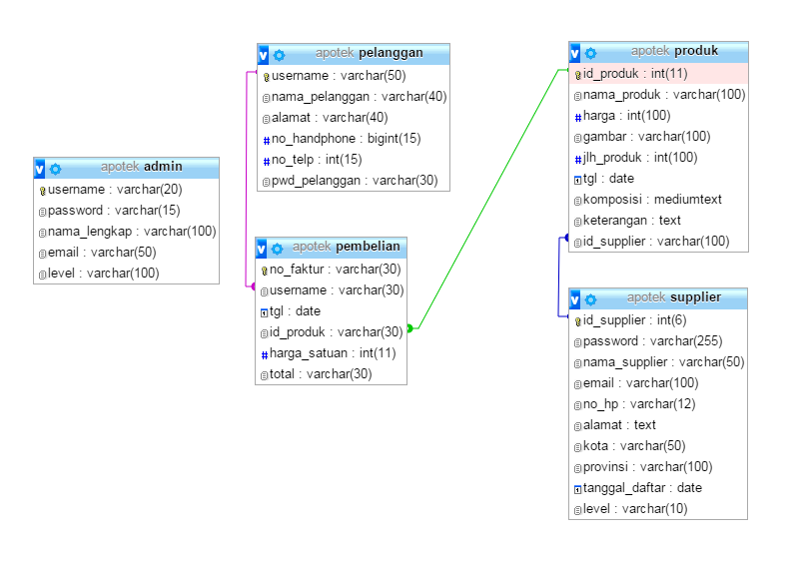
ERD
There are 5 tables for this application
Admin
Pelanggan (Customers)
Supplier
Produk (Product)
Pembelian (Transaction)

Slide 5
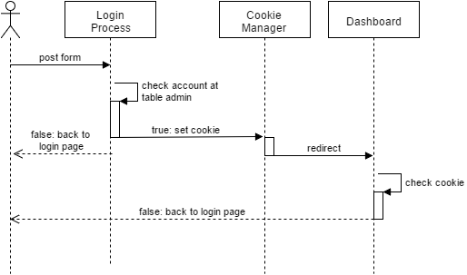
Login Process
Controllers file :
index.php as login page, contains form and auth process. Declaring cookie also write at this file after user submit login form
Dashboard.php as dashboard admin page

Slide 6
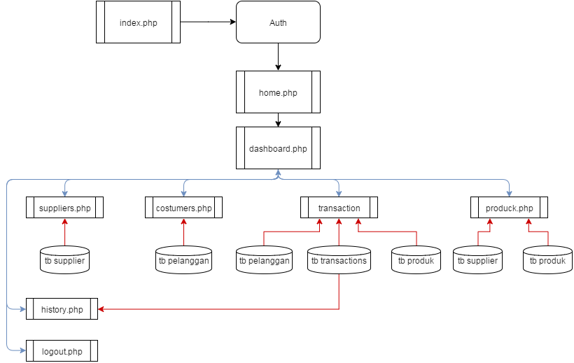
PHP File Diagram
index.php -> auth -> set cookie -> dashboard
Dashboard link to: home, admin page, customers, suppliers, products, transaction and logout
Dashboad Admin uses tb admin
Suppliers uses tb supplier
Customers uses tb pelanggan
Products uses tb produk
Transaction uses tb pembelian
Logout -> clear cookie

